Slide 1
Selecting a Land from Manhattan Borough for a Luxury Housing Complex
Chaturaka Gunatilaka 11/30/2019

Slide 2
INTRODUCTION
Buying a land which is suitable for building a housing complex is somewhat a tricky task.
Internal factors like apartment size, number of bedrooms and bathrooms, number of parking slots a tenant gets, etc. play a key role in the marketability of an apartment.
Not only internal factors but also external factors such as infrastructure facilities (e.g. hospitals, schools, supermarkets, play grounds, restaurants, etc.) adds value to such projects.
Therefore, it is advantageous for the investors to pick a land which is surrounded with at least some of these external facilities.

Slide 3
PROBLEM
In this exercise, the consultant will be looking at the infrastructure facilities available in each neighbourhood (within a 500m radius).
Each facility will be given a number of points based on the importance of the facility (e.g. medical facilities get the highest points), thus, not an unbiased experiment.
The neighborhood which scores the highest number of points will be chosen as the ideal neighborhood to build the apartment.

Slide 4
DATA AND DATA SOURCES
New York City comprises of 5 boroughs and 306 neighbourhoods.
Neighborhood details, applicable borough, latitude and longitude coordinates of each neighborhood have been obtained through:
https://geo.nyu.edu/catalog/nyu_2451_34572
Since the task is to find out a suitable neighborhood in ‘Manhattan’ borough, the rest of the data have been removed from the data set via a python operation.

Slide 5
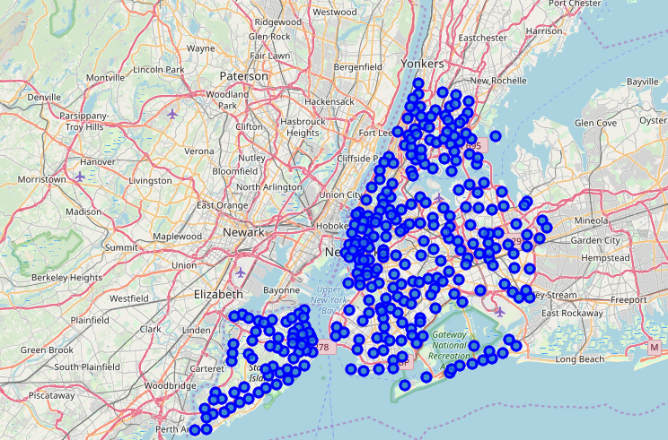
METHODOLOGY
All the neighborhoods located in New York were taken into a map.

Slide 6
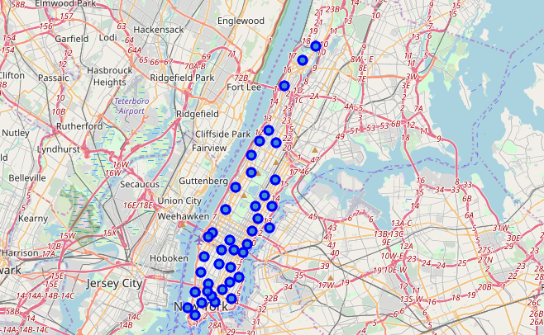
METHODOLOGY cont.
In the second step, all the neighborhoods were dropped from the dataset except the neighborhoods located inside the ‘Manhattan’ borough. Those were also taken into a separate map.

Slide 7
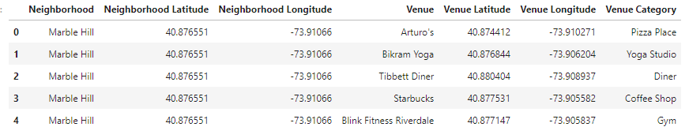
METHODOLOGY cont.
After that, the top 100 venues including the venue categories of each filtered neighborhood were obtained using the Foursquare API.

Slide 8
METHODOLOGY cont.
After that, the top 100 venues including the venue categories of each filtered neighborhood were obtained using the Foursquare API.
The objective was to identify the most important venue categories which would enhance or add value to the project.

Slide 9
METHODOLOGY cont.
As a result, the following set of venue categories were identified as the most important ones.
Doctor's Office, Medical Centre
School, High School, General College & University
Pharmacy, Drugstore
Supermarket, Grocery Store
Clothing Store
Bus Station, Bus Stop, Bus Line, Metro Station
Department Store, Discount Store, Shopping Mall, Convenience Store, Electronics Store
Bank
Gas Station
Gym, Gym / Fitness Center, Weight Loss Center

Slide 10
METHODOLOGY cont.
The similar venue categories were grouped into clusters. Each cluster was assigned with a score.
Cluster | Venue Category/Categories | Score
1 | Doctor's Office, Medical Centre | 10
2 | School, High School, General College & University | 9
3 | Pharmacy, Drugstore | 8
4 | Supermarket, Grocery Store | 7
5 | Clothing Store | 6
6 | Bus Station, Bus Stop, Bus Line, Metro Station | 5
7 | Department Store, Discount Store, Shopping Mall, Convenience Store, Electronics Store | 4
8 | Bank | 3
9 | Gas Station | 2
10 | Gym, Gym / Fitness Centre, Weight Loss Centre | 1

Slide 11
Results
The overall score of each neighborhood was shown in the following table.
Neighborhood | Overall Score
Marble Hill | 21
Chinatown | 16
Washington Heights | 65
Inwood | 27
Hamilton Heights | 21
Manhattanville | 15
Central Harlem | 2
East Harlem | 18
Upper East Side | 27

Slide 12
Results cont.
Neighborhood | Overall Score
Yorkville | 18
Lenox Hill | 13
Roosevelt Island | 27
Upper West Side | 20
Lincoln Square | 38
Clinton | 21
Midtown | 46
Murray Hill | 13
Chelsea | 13
Greenwich Village | 36
East Village | 0

Slide 13
Results cont.
Neighborhood | Overall Score
Lower East Side | 14
Tribeca | 18
Little Italy | 26
Soho | 65
West Village | 0
Manhattan Valley | 0
Morningside Heights | 22
Gramercy | 33
Battery Park City | 46
Financial District | 27
Carnegie Hill | 40
Noho | 15

Slide 14
Results cont.
Neighborhood | Overall Score
Civic Center | 23
Midtown South | 35
Sutton Place | 34
Turtle Bay | 9
Tudor City | 10
Stuyvesant Town | 3
Flatiron | 39
Hudson Yards | 32

Slide 15
Results cont.

Slide 16
Results cont.
As per the results, Washington Heights and Soho have achieved the highest overall score of 65.
Therefore, it can be stated that the investors can use one of the lands in Washington Heights or Soho to build the apartment based on the given information.
However, please note that there are other external factors such as land value, quality of the neighborhood, etc. (which are not considered in this exercise) that need to be considered when making a decision since the investors are given with two options.

Slide 17
DISCUSSION
Some of the noticeable facts;
There are three neighborhoods with zero marks.
East village
West village
Manhattan valley
These three neighborhoods are not suitable for living at all.

Slide 18
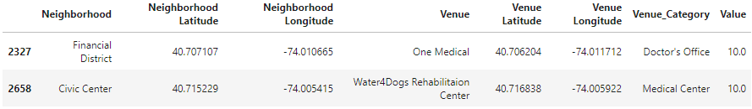
DISCUSSION
Further Analysis
In order to analyze the characteristics of the neighborhoods, the neighborhoods with medical facilities were filter out and surprisingly there were only 2 results;
Doctor’s office in Financial District
Medical center in Civic Centre
What it indicates is, Out of those 39 neighbourhoods, only two have a quick access to medical facilities.

Slide 19
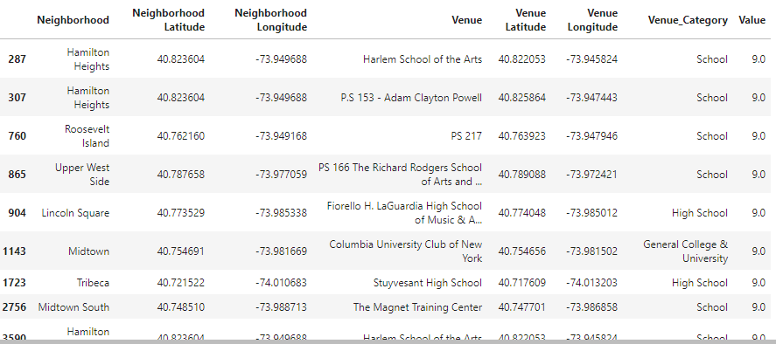
DISCUSSION
Further Analysis Cont.
The next filtering was done to find out the neighborhoods with schools/high schools/Colleges/Universities.

Slide 20
DISCUSSION
Further Analysis Cont.
The next filtering was done to find out the neighborhoods with schools/high schools/Colleges/Universities.
There are only 5 Schools, 2 High Schools and a ‘General College & University’ - Columbia University Club of New York. When it comes to drugstores and pharmacies, there are only 10 pharmacies and a drugstore.

Slide 21
CONCLUSION
During the analysis, it was identified that out of the 65 points scored by Soho, 54 points came from 9 clothing stores (more than 83%). Furthermore, it doesn’t have any of the venues mentioned below.
Doctor's Office, Medical Centre
School, High School, General College & University
Pharmacy, Drugstore
However, when it comes to Washington Heights, there is a pharmacy, grocery stores, supermarkets, banks, gyms, fitness centres and clothing stores (a wide variety of places than Soho including a pharmacy). Hence, the consultant should recommend the investor to buy the land for sale in Washington Heights.

Slide 22
THANK YOU!

